Slide 1
October 2018 | Yes We Must Coalition Austin, Texas
Identifying Barriers for Student Success: Acting with Intentionality
Wil Del Pilar VP for Higher Education @Wil_EdTrust
© Copyright 2018 The Education Trust @EdTrust /edtrust edtrust www.edtrust.org

Slide 2
Session Overview
About Ed Trust
Research on First Generation Students
Postsecondary Pathways: How Race, Ethnicity & SES Shape Choice
Institutional Selectivity
Postsecondary Persistence
Graduation Rates

Slide 3
Through our research and advocacy, The Education Trust supports work that:
Expands excellence and equity in education, from preschool through college;
Increases college access and completion, particularly for historically underserved students; and
Builds and engages diverse communities that care about education equity, and increases political and public will to act on equity issues.

Slide 4
Research on First Generation Students

Slide 5
First Generation Student Research
First generation students are less likely to enroll in college
72% of 1st Gen, 84% of those whose parents had some college and 93% of students whose parents are college graduates enroll in college.
First generation students are less likely to enter college academically prepared
Less likely to take a higher level math course
27% vs. 43% for students from households where a parent holds a bachelors degree.
Less Likely to take an AP or IB Course
First generation students are less likely to have information about the college experience
Lack familiarity with the importance of high school curriculum and impact on college readiness (Gamez-Vargas & Oliva, 2013).
Do not know how to apply, receive financial aid, or choose a major.
Less likely to know the difference between institutions, and may select one that does not suit educational needs (Arnold, Lu, & Armstrong, 2012).
18% of 1st Gen took AP or IB courses compared to 44% of students from households where parents are college graduates.
58% of 1st Gen students enroll in college immediately following high school compared to 79% of continuing generation students.

Slide 6
First Generation Student Research
27% of 1st Gen students come from households earning $20K annually or less compared to 6% for continuing generations students.
50% of 1st Gen students come from households earning between $20K and 50K compared to 23% of continuing generation students.
First generation students are less likely to persist to the 3rd year
33% of 1st Gen students leave by their 3rd year without earning a degree compared to 14% for continuing generation students.
First generation students are more likely to leave college because of expenses
More Likely to come from a low-income household
Only 11% of low-income, 1st Gen students will have a college degree compared to about 55% for continuing generation students.
54% of 1st Gen students who left postsecondary left because they could not afford to stay enrolled
First generation students are more likely to borrow money for college than their peers
First generation students are more likely to attend 2 Year Institutions
First generation students are less likely to earn a degree in 6 years
52% of 1st Gen students start at a 2 year institutions compared to 28% of continuing generation students.
9% of 1st Gen students attend private not for profits compared to 23% of continuing generation students.

Slide 7
How Do You Stack Up Against the Research?
Did you enroll in college immediately following high school?
Did you feel academically prepared for college?
Did you understand the college application, financial aid process or had information on how to choose your major?
Did you come from a low income household?
Did you stop out of college?
Did you start your education at a 2 year college?

Slide 8
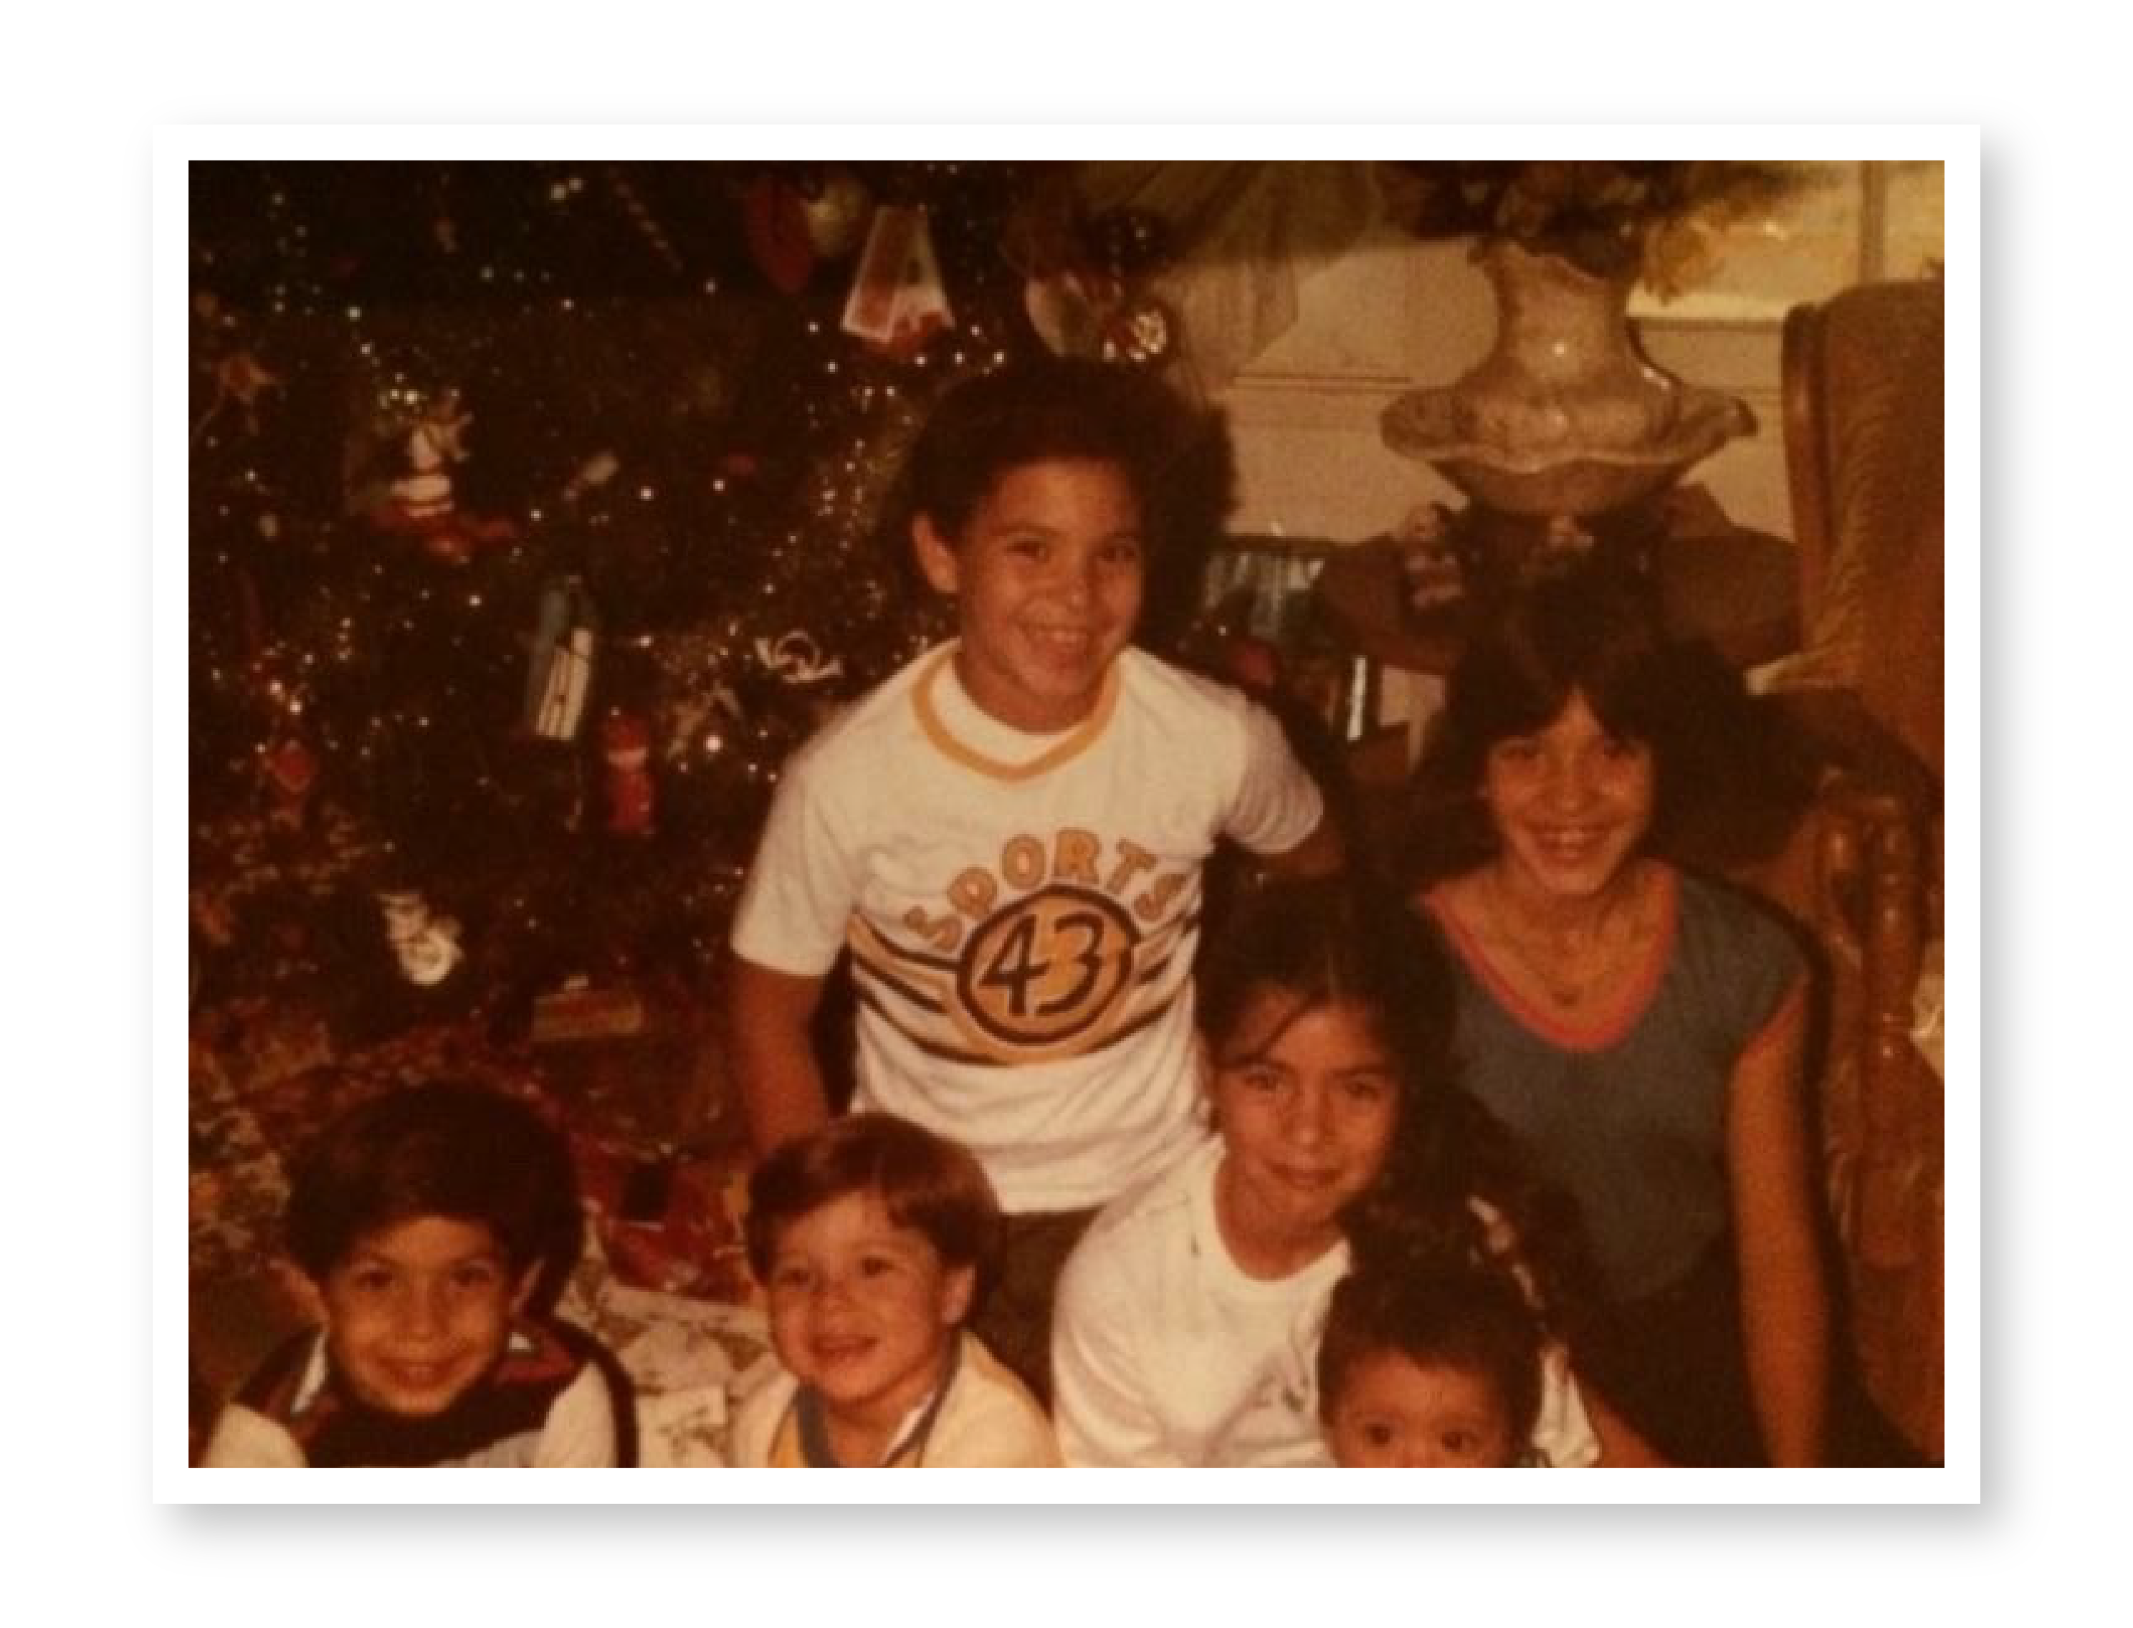

Notes:
Good Afternoon! My name is Wil Del Pilar, I grew up 9 miles away from here in Carson, California. I am the oldest son of Wilfredo and Lillian Del Pilar. My father was born in Puerto Rico and my mother in New York to Puerto Rican parents. I am one of five children raised in a bilingual household to a father who took some college courses as an adult and my mother, a graduate from Carson High School. My father was a protestant minister in Gardena, CA until he retired and my mother worked alongside my father in the church. We moved frequently growing up and I can recall changing schools 7 times.

Slide 9
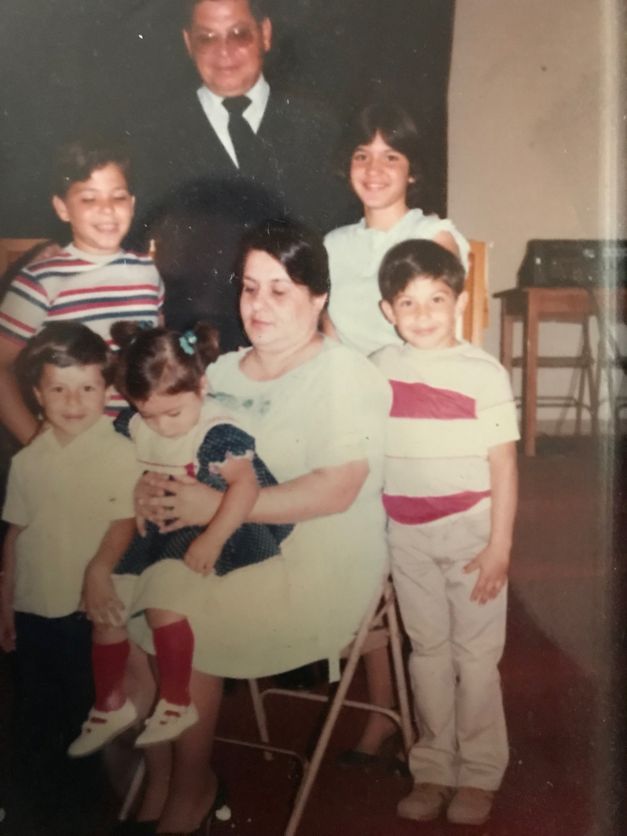
Notes:
When my parents enrolled me in high school the guidance counselor, who had also been my mom’s counselor, enrolled me as a teachers aid for 3 classes in a 6 period day. My parents were not engaged in my education and while my father had and still has a love for reading, education was left to schools. There existed a trust from parents and communities that schools would make the right educational choices for students. In my case, the decision my counselor made was that I didn’t need to enroll in college prep courses because “I wasn’t college material, I was supposed to get a job after graduation”. As a result, I was placed in courses that failed to challenge me, I did not take the SAT, nor did I ever engage in a conversation about test prep, the FAFSA or college options. High School graduation was the goal.

Slide 10
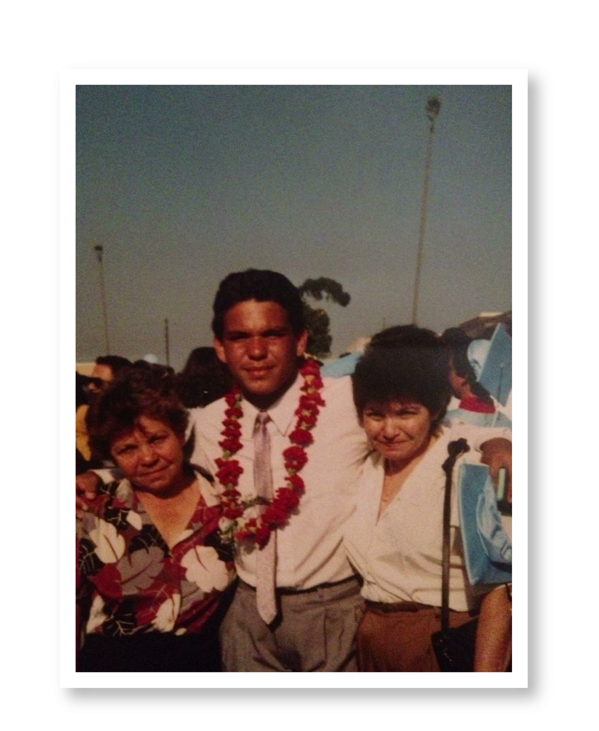
Notes:
I made it to graduation and, not surprisingly, I didn’t go to college immediately following high school. I worked full time and began doing research on colleges, I bought an SAT prep book, applied to colleges and completed the FAFSA on my own. The first time I visited a college campus was when I moved into the dorms and thanks to support of family and mentors in college I was able to be the first person in my family to graduate with a bachelor’s degree, and years later a masters from Cal State Dominguez Hills and finally with a Ph.D.
I am a first-generation college student, I am a Latino, I was low-income, received a Pell Grant and I tested into remedial math and English. I shouldn’t have made it. I survived my education…
Today’s students should not have to survive education, they should thrive in education.

Slide 11
How Do I Stack Up Against the Research?
Did you enroll in college immediately following high school?
NO
Did you feel academically prepared for college?
NO
Did you understand the college application, financial aid process or had information on how to choose your major?
NO
Did you come from a low income household?
YES
Did you stop out of college?
YES
Did you start your education at a 2 year college?
YES
Notes:
The Research Doesn’t Define 1st Gen Students
The research is not the rule, we can’t operate from deficit models and need to use data to inform our interventions and strategies.
We should design college support structures that guarantee that students make it to graduation, not reinforce statistics
Beyond this, we must change systems. We need to ensure that students are provided opportunities to thrive within your institutions and I hope we can have a conversation about access, persistence and graduation. I attend lots of conferences and believe that the answers to improving access persistence and graduation are in the room. The experts are here and I hope we can get some examples of institutional policies and practices that are making a difference

Slide 12
Postsecondary Access

Slide 13
What we Know About Low-Income Students & Students of Color
Are more likely to have attended ineffective elementary and secondary schools.
Are less likely to have access to college prep coursework.
High schools with high Black and Latino enrollment were less likely to offer Algebra II and Chemistry courses compared to schools with low Black and Latino enrollment.
Are more likely to live in underdeveloped areas within major cities or in sparsely populated rural areas.

Slide 14
Persistent Disadvantage
Michael Hurwitz and Jason Lee found that grades have been rising since at least the 1990s.
The study finds that grade inflation has been most noticeable at high schools with students who are wealthier than average and where the majority of students are white.
Research shows that admissions test (SAT/ACT) have an economic, racial and gender bias.
Research evidence consistently finds that Black and Latino students score lower on the SAT

Slide 15
Persistent Disadvantage
Colleges use non-academic factors in admissions decisions like:
Legacy status (9.1%), extracurricular activities (31%), and indicators of demonstrated interest (39%).
Institutions take the group of students deemed academically qualified based on formulas that disadvantage students and judge them on factors that further exacerbate inequities.
Students can’t participate in debate if they’re busy working a part time job to, and they may not have the time or resources to travel out of town for campus tours, both of which would score them extra points in holistic review.
Wealthy students are also more likely to have access to a college counselor in their high school to help them write admissions essays, apply for scholarships, and tailor their applications.

Slide 16
What Policies/Practices Can Increase Pipeline into College
Create/establish postsecondary pathways
Educate parents and students on value of postsecondary education
Improve counseling
Programs like TRIO, Gear Up provide information and aid with the transition
Postsecondary and high school partnerships are changing school culture.
Use of Alternative Measures of Student Success away from standardized test
Provide students access to postsecondary courses while in high school/dual enrollment
Text reminders to students decreases summer melt
Information alone is not enough, low-income students and underrepresented students often require additional support

Slide 17
Identifying Policy/Practice Opportunities
Within your institutional context what policies and practices will improve the postsecondary access for 1st Generation students?
What institutional barriers can you identify/remove to improve postsecondary access for 1st Generation students?
What data do you have and/or do you need to assess that these policies/practices are effective?

Slide 18
Postsecondary Persistence

Slide 19
First Year Persistence by Race/Ethnicity

Slide 20
First Year Persistence at 4 Year Private Colleges

Slide 21
What Policies/Practices Increase Persistence
Texting reminders to students about enrollment deadlines
Student advising around major and career choice
Improving connections between workforce and education
Wrap around support services improve persistence
Student Success Teams
Models like CUNY ASAP show increases to persistence for low-income students and students of color.
Accountability policies and policies that increase support for institutions enrolling high numbers of underrepresented students improve persistence.

Slide 22
Identifying Policy/Practice Opportunities
Within your institutional context what policies and practices will improve the postsecondary persistence for 1st Generation student populations?
What institutional barriers can you identify/remove to improve postsecondary persistence for 1st Generation students?
What data do you have and do you need to assess policies?

Slide 23
Graduation Rates

Slide 24
Percentage of High School Sophomores in 2002 that Earned a Bachelor’s Degree by 2012
Lowest Income Quartile
Highest Income Quartile
Notes:
There are two things we have learned from years of studying college completion. Income matters and race matters. Young adults from high-income families are 4 times more likely to earn bachelor’s degrees than students in the lowest income quartile. Think of it this way. 100 low-income students enter college and after 6 years only 15 earn a degree. Conversely, 100 students from the highest income quartile enter college and after 6 years 60 have earned a degree, income matters.

Slide 25
6YR Graduation Rate at 4YR Institutions (2015)
Notes:
The other factor in graduation is race/ethnicity. When we look at 6 year graduation rates the disparities are telling. Over 63% of White students graduate from college at 4 years institutions in 6 years. Compare that to 39% of black students, a difference of 23 percentage points. Latino students have made progress over the past several years but we still see a completion gap of 10 percentage points. I’ll use my example of the 100 students here to illustrate. 100 White students start college and after 6 years 37 leave college without a degree. 100 Latino students start college and after 6 years 47 leave college without a degree. 100 Black students start college and after 6 years 61 leave college without a degree. We must do better for by our students.

Slide 26
What Policies/Practices Increase Graduation Rates
Increase student support structures to meet student
Intrusive advising, emergency grants,
Emerging evidence on developmental ed reform
Identification of course redesign and redesign of developmental education
Emerging evidence on campus climate for students of color (faculty training, faculty diversity, etc.);
Emerging evidence on basic needs insecurity (homelessness, hunger, unique challenges facing undocumented students like lack of access to healthcare).
Use of data to identify and direct interventions at students most likely to drop out

Slide 27
Identifying Policy/Practice Opportunities
Within your institutional context what policies and practices will improve the graduation rates for 1st Generation student populations?
What institutional barriers can you identify/remove to improve graduation rates for 1st Generation Students?
What data do you have and do you need to assess policies?

Slide 28

Notes:
There’s a saying about higher education. Higher Education, unimpeded by 200 years of progress. Many of the things we do in higher education have not changed despite advances in technology and what we know about learning, despite what we know about student development and student services, despite the fact that the students we serve are different than the students primarily served by higher education 100 years ago, 50 years ago, 25 years ago or even 10 years ago. The old models are not working for today’s student and if we are going to make progress in equitably serving todays students we need to be bold, we need to change the model, we need to transform practice and teaching to close gaps and make progress. We need to ensure that our institutions are engines of social mobility not engines of social reproduction.

