Slide 1
Contributing Factors to the Success of Hispanic Males at Heritage University
Melissa Hill, Ph.D., Interim Vice President for Student Affairs

Slide 2
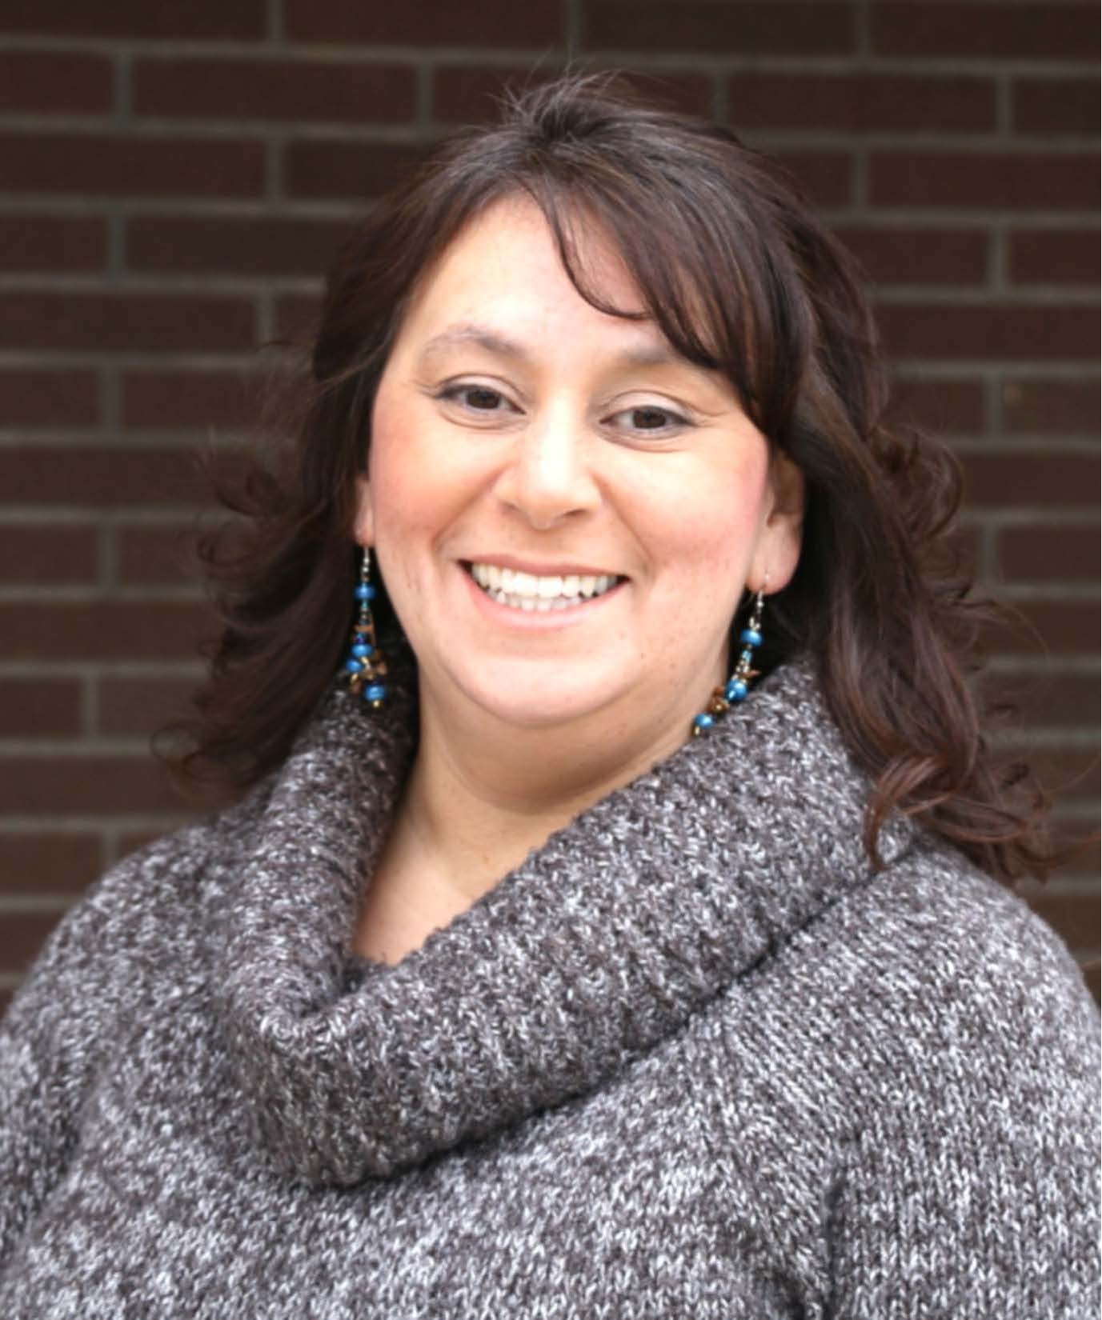
Melissa Hill, Ph.D.,
Interim Vice President for Student Affairs
Student Life
Academic Advising
TRIO/CAMP/HEP Federal Grant Programs
ADA and Mental Health Counseling
Title IX Coordinator
Advocacy Program: HU CARES
Born in Yakima Valley, First Generation,
eight years at HU, Hispanic
3240 Fort Road Toppenish, WA 98948 (509) 865-8500 Phone, Extension - 5807
(888)272-6190 Toll Free
(509) 969-4013 Text or Message
Hill_m@heritage.edu

Slide 3
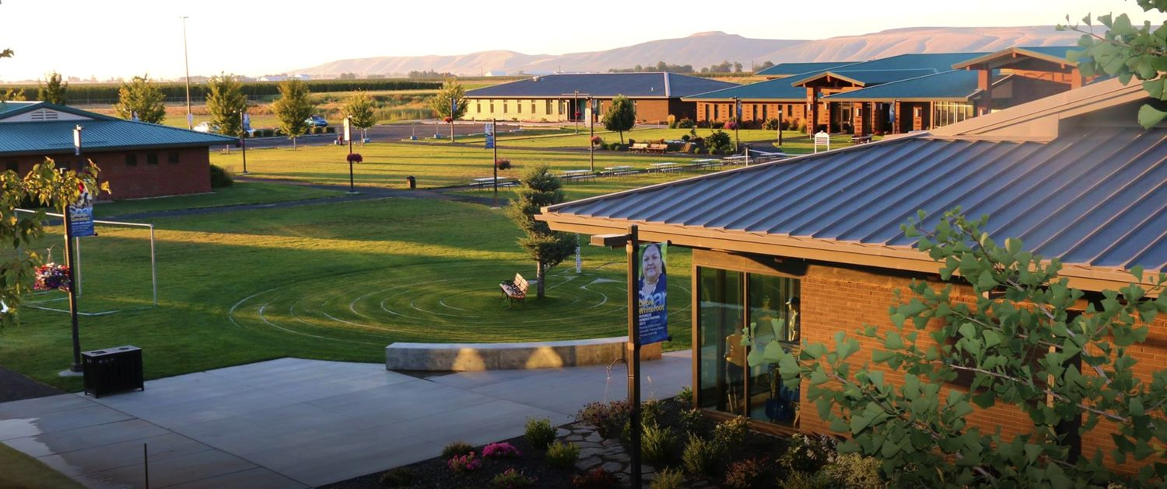
Heritage University
Student enrollment averages about 1100 degree seeking students a year
Hispanic Serving Institution, 69% Hispanic/Latino, 14% Caucasian, 12% American Indian 85% of Heritage students are the first in their family to attend college
Financial Aid eligibility 91% of Heritage students receive financial aid
Rural farming communities, agriculture is the primary source of income

Slide 4
WHY?
Are HISPANIC MALES doing better at Heritage University

Slide 5
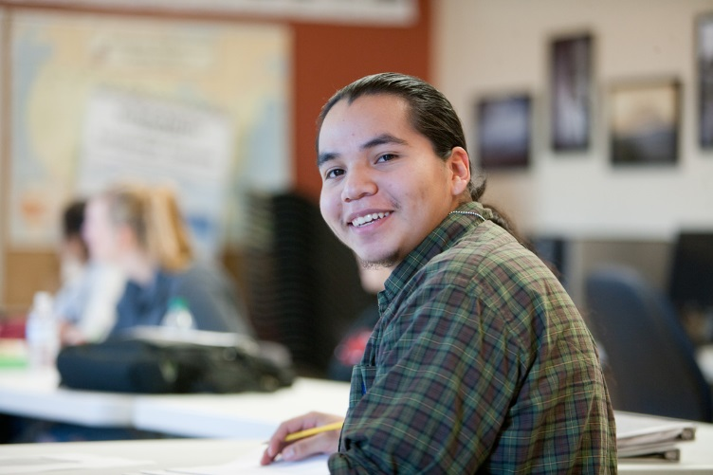
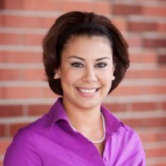
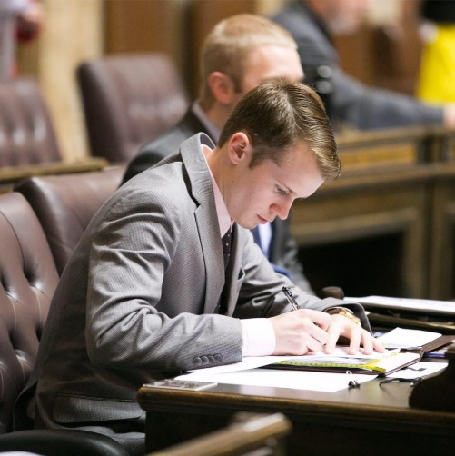
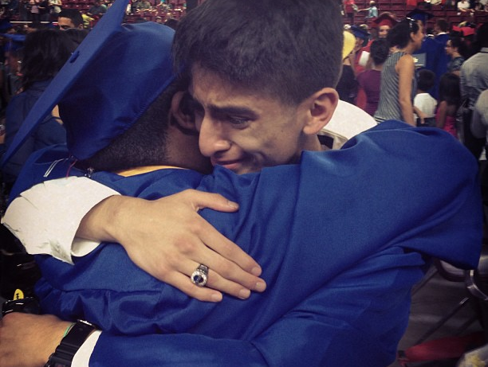
Is it our mission statement?
Our Mission
Heritage University empowers a multi-cultural and inclusive student body to overcome the social, cultural, economic and geographic barriers that limit access to higher education. Rooted in the homeland of the Yakama Nation, we embrace transformational student-centered education that cultivates leadership and a commitment to the promotion of a more just society.

Slide 6
Everyone is doing better, Are we getting better in general at retaining students?
73% Retention

Slide 7
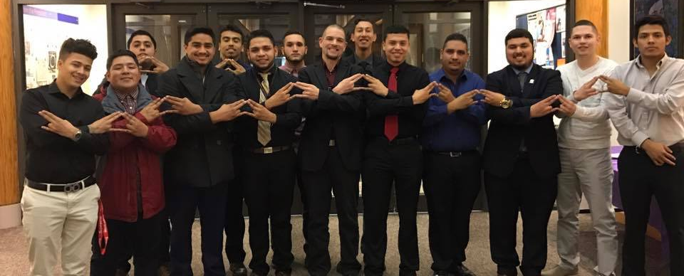
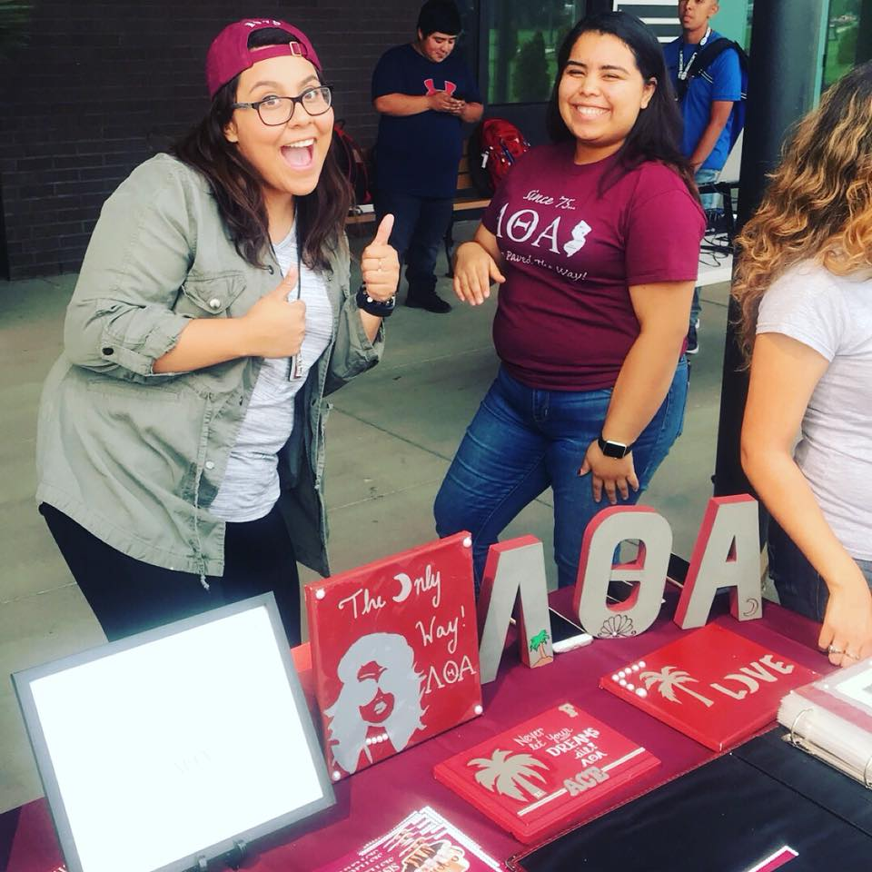
HU allowed for Greeks to begin in 2013. Maybe our fraternities and sororities are helping to retain more male students?

Slide 8
Issues/Challenges
Child Care
Transportation
Failing Assignments
Bills/Gas Money
No books
Working 40 hrs. wk
Pregnancy
Death in the family
Directionless
Family support
Mental Health Issues
Hunger / Homeless
HU offers a robust advocacy program that send early alerts to staff in the Office of Student Affairs, perhaps our work with males students is paying off
Personalized Support
Emergency Funding
Food or clothing
Transportation support
Counseling services

Slide 9
Mother’s and Father’s Highest Level of Education
Each year we conduct the College Success Inventor survey during New Student Orientation, maybe we understand the barriers our students face?
Question to first year students | Mother | Father
Eight (8) years or less of elementary school | 10.2% | 41.5%
Some high school but no diploma | 39.5 % | 17.7%
A high school diploma or equivalent | 17.0 % | 15.0%
1 to 3 years of college (including study at a technical, community, or junior college) | 8.2% | 3.3%
A 4-year undergraduate college degree (bachelor’s degree) | 0.7% | 0.7%
A master's degree | 3.4 % | 0.7%
A professional degree (medicine, dentistry, law, philosophy, or other similar degrees) | 0% | 0%
Notes:
Add Footnote on CSI Data

Slide 10
Framework
Access, Family, Support & Motivation
Services to support student success:
Early alert system – Advocacy (HU CARES)
Supplemental Instruction & Tutoring
Study Skills course for probation*
Mental health counseling
Individual success plans*
Emergency funding*
Food sustainability
Mentoring/coaching*
Advocacy Alerts
Individual
Success Plan
Student Success
Academic Achievement
Financial Support & Resources
Academic & Financial Plan

Slide 11
Maybe we better ask?
Why HISPANIC MALES are doing better at Heritage University

Slide 12
Themes from our focus group discussion
O
The Group of Six n=6
All first generation
All Hispanic
No one’s parents had a college degree and only one parent had a high school diploma
All grew up speaking Spanish at home and learned English
All of them had the support of their family
Motivation:
Family and personal drive
Peer and instructor support
Free tutoring in Math
Community, family feeling
Parents consistently said we want something better for you than working in the fields

Slide 13
Student Success Chart
Framework for understanding student success.
Access – getting to campus (Core theme)
Academic ability – able to do the work
Financial Resources – Pell, Grants, Work
Motivation & Vision – a desire to make it
Motivation
Vison
Academic Ability
Access
Financial Resources
Notes:
Comments:
Les, nothing to add…
Kathleen – I don’t see anything right off that I would add the component that the academic committee is talking about his having input into how they define success. Advising sessions to capture what their expectations are for time to completion, (Goals)
Exit survey completion and hold students accountable for that…
It is not necessarily a different element PT, and they set the goals.
Academic meeting, data points that come from two different directions on this
John – looking it over more, and glad she mentioned engagement and I have advocated a lot and retention has a qualitative aspect human to human. Engagement starts to address that… student life, critical students need to connect with someone.
Ellen – listening and I am of the same mind as Kathaleen find out what each students considers success for themselves. Unrealistic or intimidated by expectations and I have done some research on predictors of success for graduate school. I would encourage you to begin to ask the students.
Mimi – Agree with what has been

